Slide 1







Slide 2
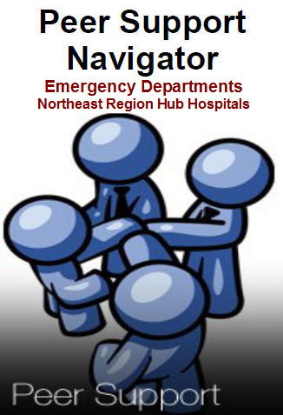






Slide 3
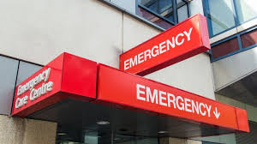

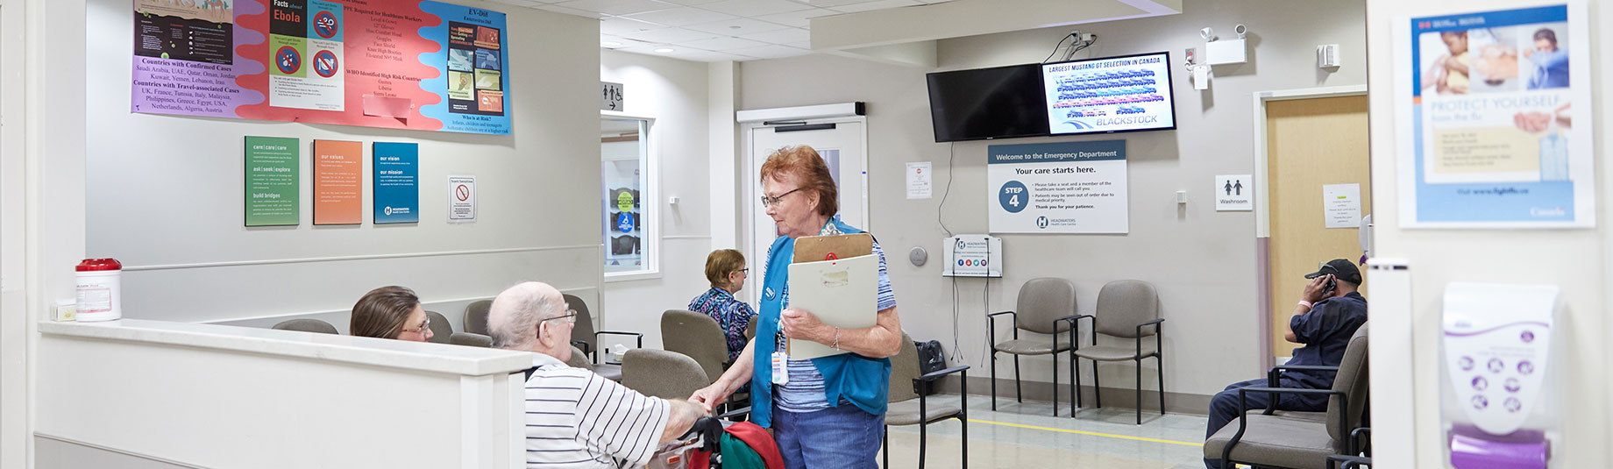


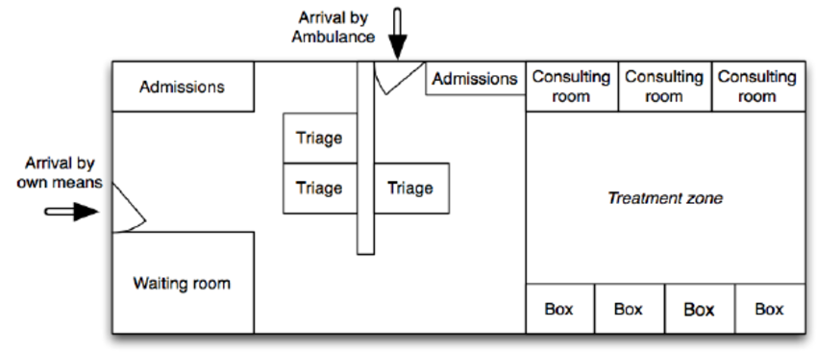
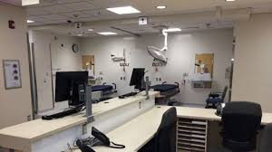


Slide 4

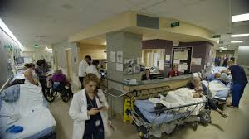

Slide 5
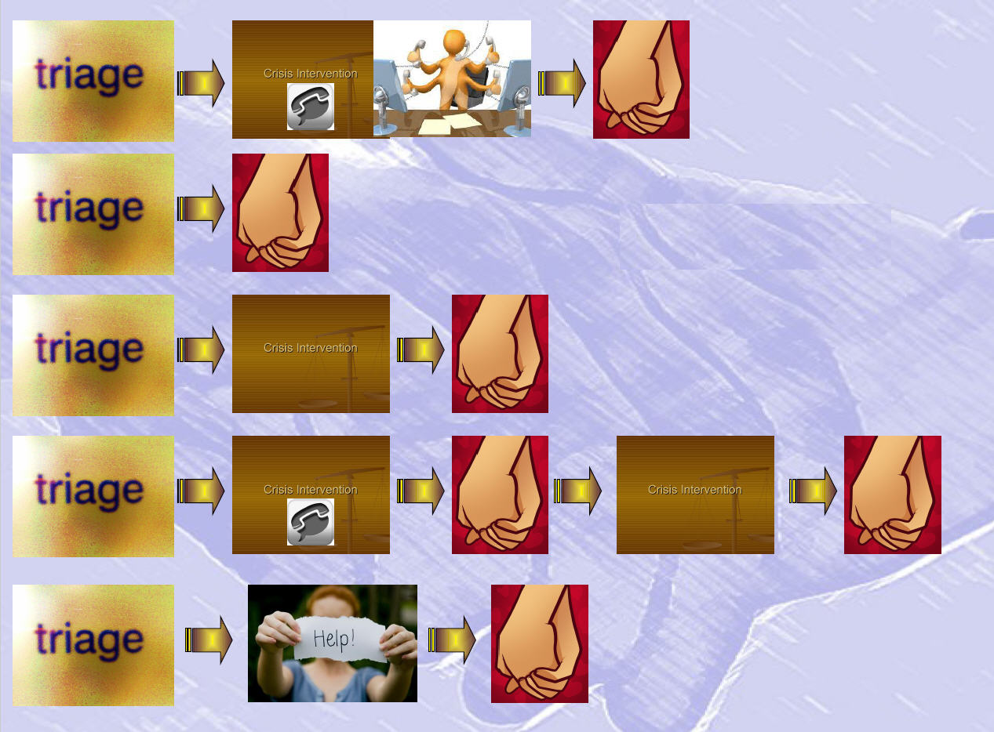

Slide 6


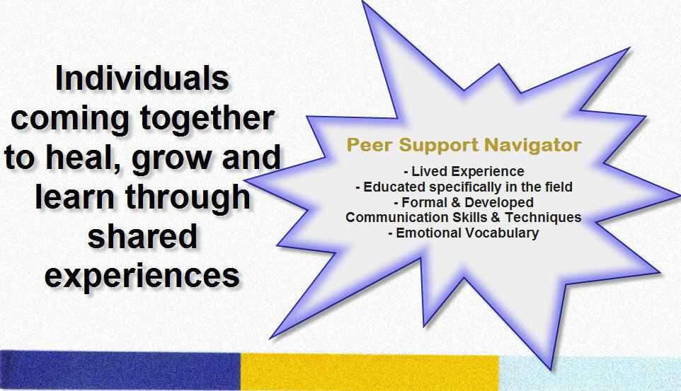

Slide 7





Slide 8
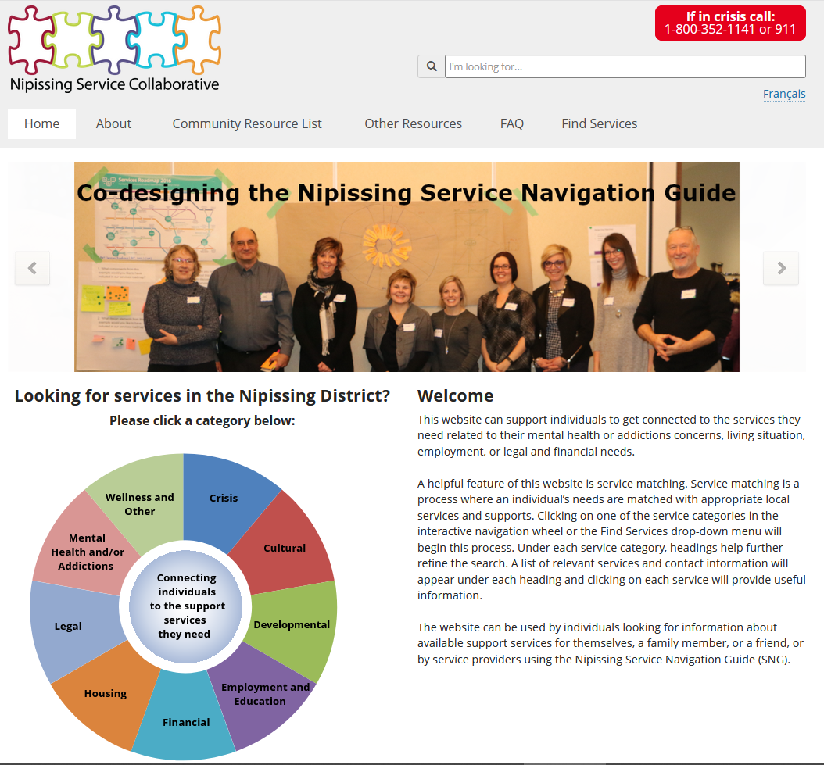
NAVIGATION WITHIN HOSPITAL
OUTPATIENT SERVICES
TO
COMMUNITY
MH&A
SERVICES

Slide 9

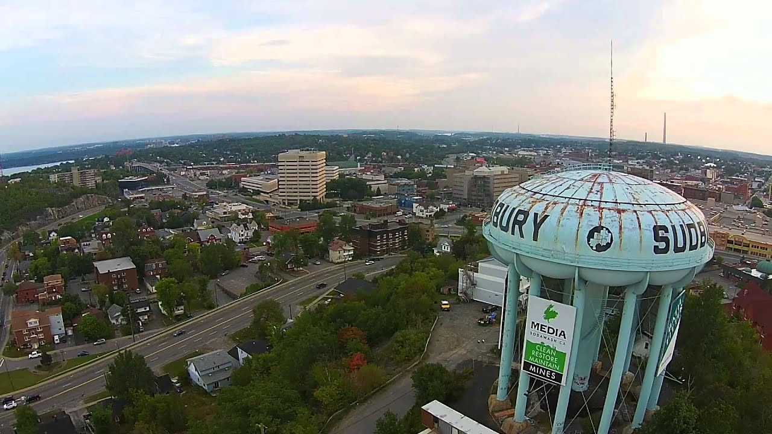

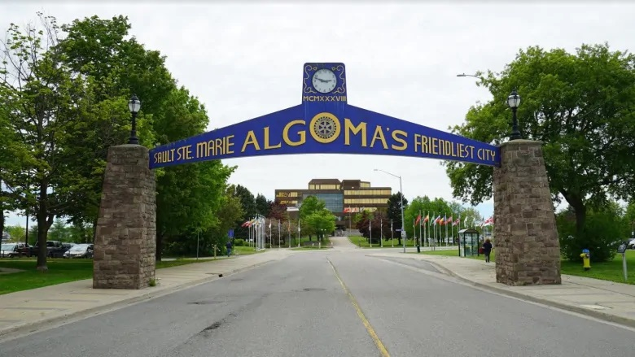
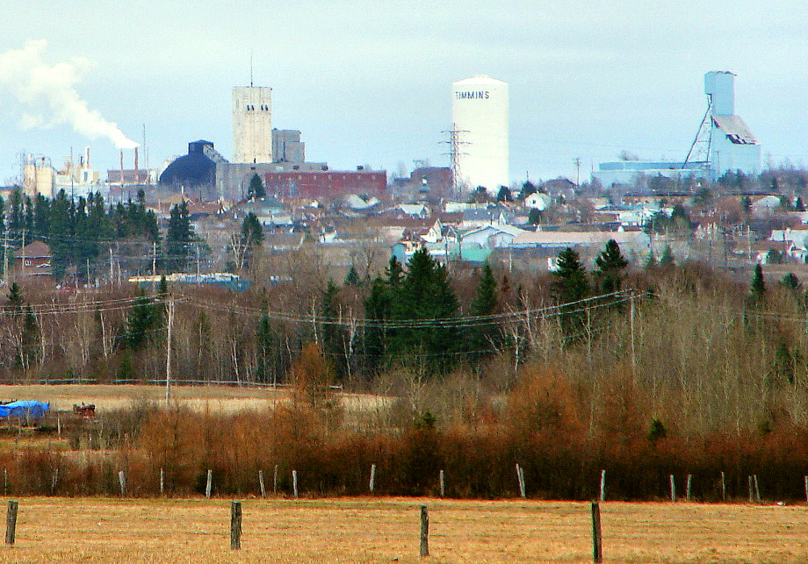

Slide 10
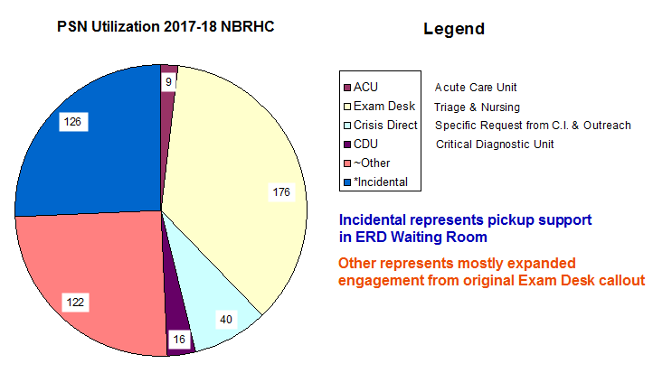
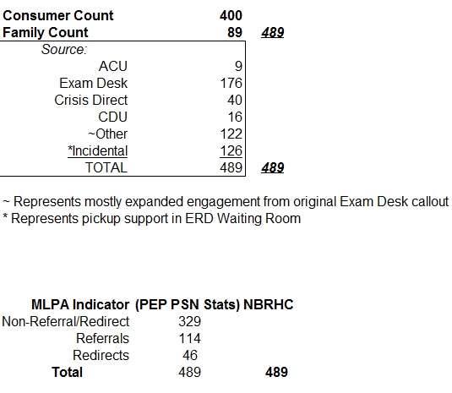

Slide 11
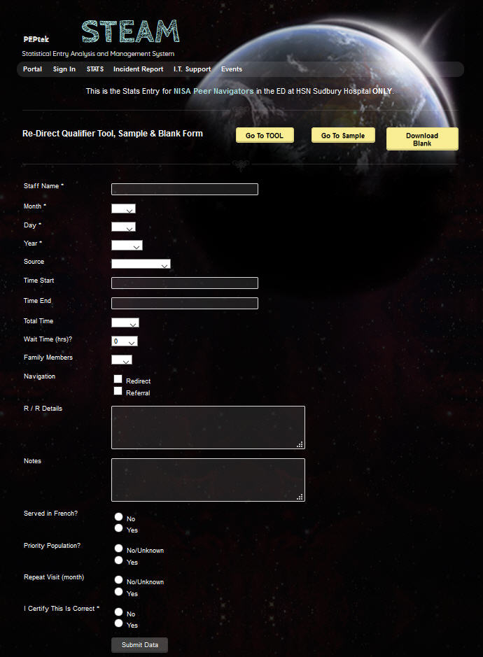

Slide 12
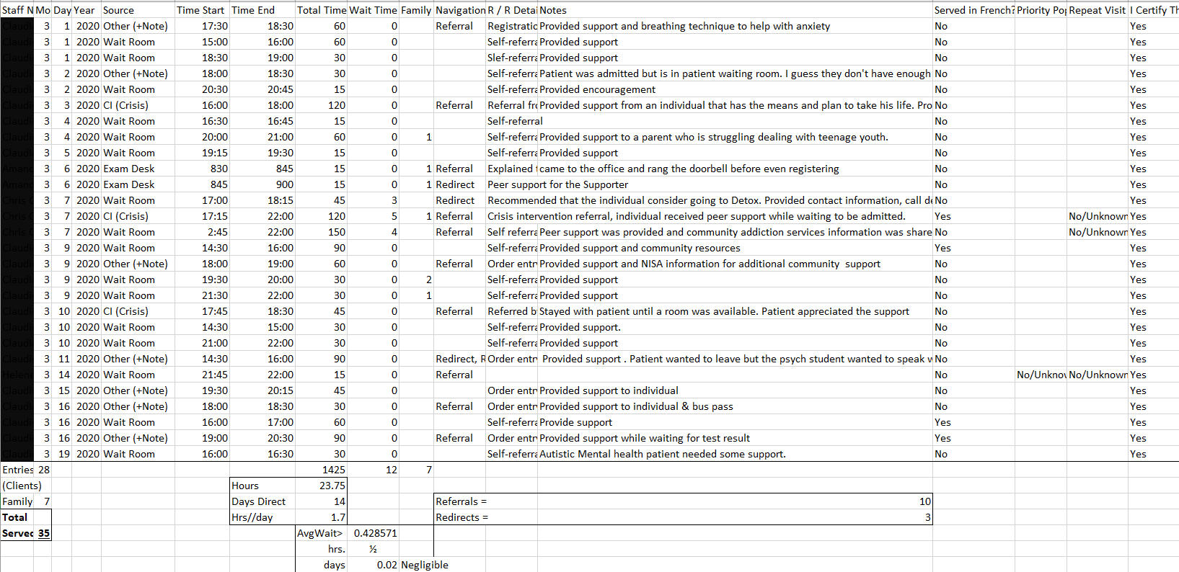

Slide 13


Slide 14
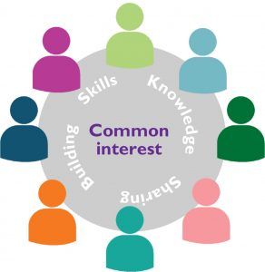



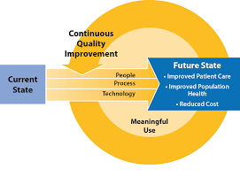

Slide 15
Peer Support Navigator - Emergency Department – 6 Quarters Work Plan
Key Deliverables if Funding Extended
Task
Q3 – 2020/21
Q4 – 2020/21
Q1 – 2021/22
Q2 – 2021/22
Q3 – 2021/22
Q4 – 2021/22
Stabilize re-deployment of PSNs to EDs (where not in service)
Site Visits to train and launch Community of Practice plus conformal practice discovery and training
Community of Practice utilization and continuity
Community of Practice Handover
Continuous Quality Improvement & Enhanced Navigation Tool(s) Methods – Test and Train : Deploy
Hospital/Agency/Community Navigation Linkages- Care Paths
Data Collection and Analysis / Comparative examinations
Database / DataStore / Forms Management stabilization for eventual handoff to agencies
PSN relationship development – service addition to other Emergency Department MH&A partners
Community of Interest – Initial Promotion
Placeholders in designs and development towards potential Rural Hospital expansions
Today

Slide 16
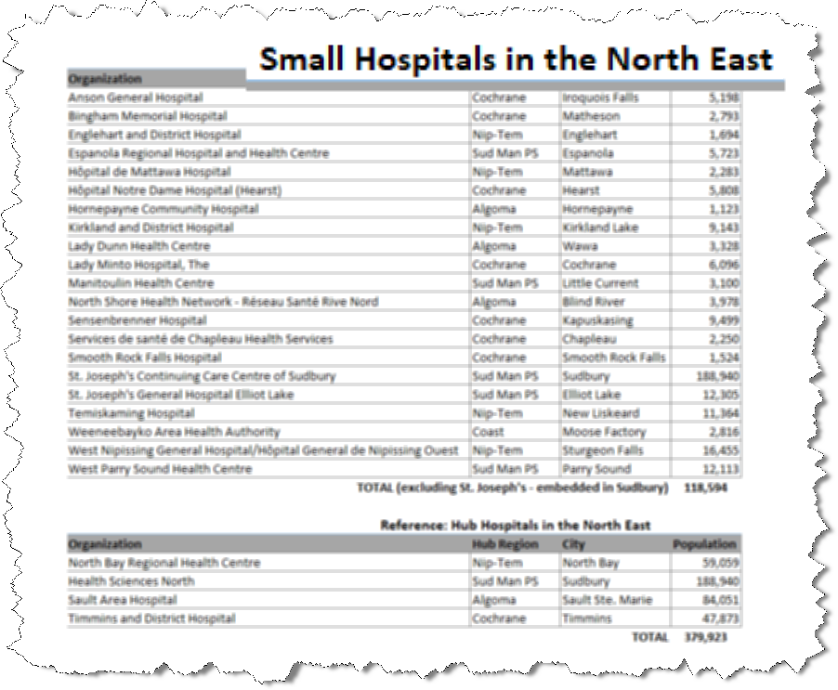

Maybe even…

Slide 17
Sudbury had their official Launch with NISA & HSN
Then COVID ☹
We anxiously anticipate the opportunity to have our official
openings for Timmins and Sault Ste. Marie and merely
await a safe and stable occasion to move this forward.
In the meantime, hats off to our frontline Peer Support
Workers and our ED Navigators in all 4 hub hospitals;
Working diligently to be there for everyone that needs…
One Person at a Time!
Peer Support Strong

